Slide 1
Distributed File Systems
VFSTR
Notes:
Assumptions:
Graduate level
Operating Systems
Making Choices about operation systems
Why a micro-century? …just about enough time for one concept

Slide 2
Distributed Files Systems (DFS)
A special case of distributed system
Allows multi-computer systems to share files
  Even when no other IPC or RPC is needed
Sharing devices
  Special case of sharing files
E.g.,
  NFS (Sun’s Network File System)
  Windows NT, 2000, XP
  Andrew File System (AFS) & others …
VFSTR

Slide 3
Distributed File Systems (continued)
One of most common uses of distributed computing
Goal: provide common view of centralized file system, but distributed implementation.
  Ability to open & update any file on any machine on network
  All of synchronization issues and capabilities of shared local files
VFSTR

Slide 4
Naming of Distributed Files
Naming – mapping between logical and physical objects.
A transparent DFS hides the location where in the network the file is stored.
Location transparency – file name does not reveal the file’s physical storage location.
  File name denotes a specific, hidden, set of physical disk blocks.
  Convenient way to share data.
  Could expose correspondence between component units and machines.
Location independence – file name does not need to be changed when the file’s physical storage location changes.
  Better file abstraction.
  Promotes sharing the storage space itself.
  Separates the naming hierarchy from the storage-devices hierarchy.
VFSTR

Slide 5
DFS – Three Naming Schemes
Mount remote directories to local directories, giving the appearance of a coherent local directory tree
  Mounted remote directories can be accessed transparently.
  Unix/Linux with NFS; Windows with mapped drives
Files named by combination of host name and local name;
  Guarantees a unique system wide name
  Windows Network Places, Apollo Domain
Total integration of component file systems.
  A single global name structure spans all the files in the system.
  If a server is unavailable, some arbitrary set of directories on different machines also becomes unavailable.
VFSTR

Slide 6
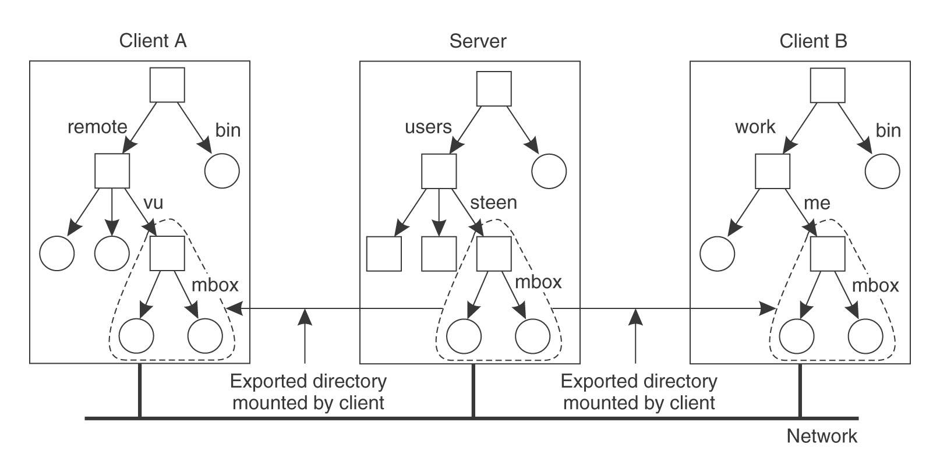
Mounting Remote Directories (NFS)
VFSTR

Slide 7
Mounting Remote Directories (continued)
Note:– names of files are not unique
    As represented by path names
E.g.,
    Server A sees : /users/steen/mbox
    Client A sees: /remote/vu/mbox
    Client B sees: /work/me/mbox
Consequence:– Cannot pass file “names” around haphazardly
VFSTR

Slide 8
Mounting Remote Directories in NFS
More later …
VFSTR

Slide 9
DFS – File Access Performance
Reduce network traffic by retaining recently accessed disk blocks in local cache
Repeated accesses to the same information can be handled locally.
  All accesses are performed on the cached copy.
If needed data not already cached, copy of data brought from the server to the local cache.
  Copies of parts of file may be scattered in different caches.
Cache-consistency problem – keeping the cached copies consistent with the master file.
  Especially on write operations
VFSTR

Slide 10
DFS – File Caches
In client memory
  Performance speed up; faster access
  Good when local usage is transient
  Enables diskless workstations
On client disk
  Good when local usage dominates (e.g., AFS)
  Caches larger files
  Helps protect clients from server crashes
VFSTR

Slide 11
DFS –Cache Update Policies
When does the client update the master file?
  I.e. when is cached data written from the cache to the file?
Write-through – write data through to disk ASAP
  I.e., following write() or put(), same as on local disks.
  Reliable, but poor performance.
Delayed-write – cache and then written to the server later.
  Write operations complete quickly; some data may be overwritten in cache, saving needless network I/O.
  Poor reliability
    unwritten data may be lost when client machine crashes
    Inconsistent data
  Variation – scan cache at regular intervals and flush dirty blocks.
VFSTR

Slide 12
DFS – File Consistency
Is locally cached copy of the data consistent with the master copy?
Client-initiated approach
  Client initiates a validity check with server.
  Server verifies local data with the master copy
    E.g., time stamps, etc.
Server-initiated approach
  Server records (parts of) files cached in each client.
  When server detects a potential inconsistency, it reacts
VFSTR

Slide 13
DFS – Remote Service vs. Caching
Remote Service – all file actions implemented by server.
  RPC functions
  Use for small memory diskless machines
  Particularly applicable if large amount of write activity
Cached System
  Many “remote” accesses handled efficiently by the local cache
    Most served as fast as local ones.
  Servers contacted only occasionally
    Reduces server load and network traffic.
    Enhances potential for scalability.
  Reduces total network overhead
VFSTR

Slide 14
DFS – File Server Semantics
Stateless Service
  Avoids state information in server by making each request self-contained.
  Each request identifies the file and position in the file.
  No need to establish and terminate a connection by open and close operations.
  Poor support for locking or synchronization among concurrent accesses
VFSTR

Slide 15
DFS – File Server Semantics (continued)
Stateful Service
  Client opens a file (as in Unix & Windows).
  Server fetches information about file from disk, stores in server memory,
    Returns to client a connection identifier unique to client and open file.
    Identifier used for subsequent accesses until session ends.
  Server must reclaim space used by no longer active clients.
  Increased performance; fewer disk accesses.
  Server retains knowledge about file
    E.g., read ahead next blocks for sequential access
    E.g., file locking for managing writes
      Windows
VFSTR

Slide 16
DFS –Server Semantics Comparison
Failure Recovery: Stateful server loses all volatile state in a crash.
  Restore state by recovery protocol based on a dialog with clients.
  Server needs to be aware of crashed client processes
    orphan detection and elimination.
Failure Recovery: Stateless server failure and recovery are almost unnoticeable.
  Newly restarted server responds to self-contained requests without difficulty.
VFSTR

Slide 17
DFS –Server Semantics Comparison
(continued)
…
Penalties for using the robust stateless service: –
  longer request messages
  slower request processing
Some environments require stateful service.
  Server-initiated cache validation cannot provide stateless service.
  File locking (one writer, many readers).
VFSTR

Slide 18
DFS – Replication
Replicas of the same file reside on failure-independent machines.
Improves availability and can shorten service time.
Naming scheme maps a replicated file name to a particular replica.
  Existence of replicas should be invisible to higher levels.
  Replicas must be distinguished from one another by different lower-level names.
Updates
  Replicas of a file denote the same logical entity
  Update to any replica must be reflected on all other replicas.
VFSTR

Slide 19
Example Distributed File Systems
NFS – Sun’s Network File System (ver. 3)
    Tanenbaum & van Steen, Chapter 11
NFS – Sun’s Network File System (ver. 4)
    Tanenbaum & van Steen, Chapter 11
AFS – the Andrew File System
    See Silbershatz §17.6
VFSTR

Slide 20
NFS
Sun Network File System (NFS) has become de facto standard for distributed UNIX file access.
NFS runs over LAN
  even WAN (slowly)
Any system may be both a client and server
Basic idea:
  Remote directory is mounted onto local directory
  Remote directory may contain mounted directories within
VFSTR

Slide 21
Mounting Remote Directories (NFS)
VFSTR

Slide 22
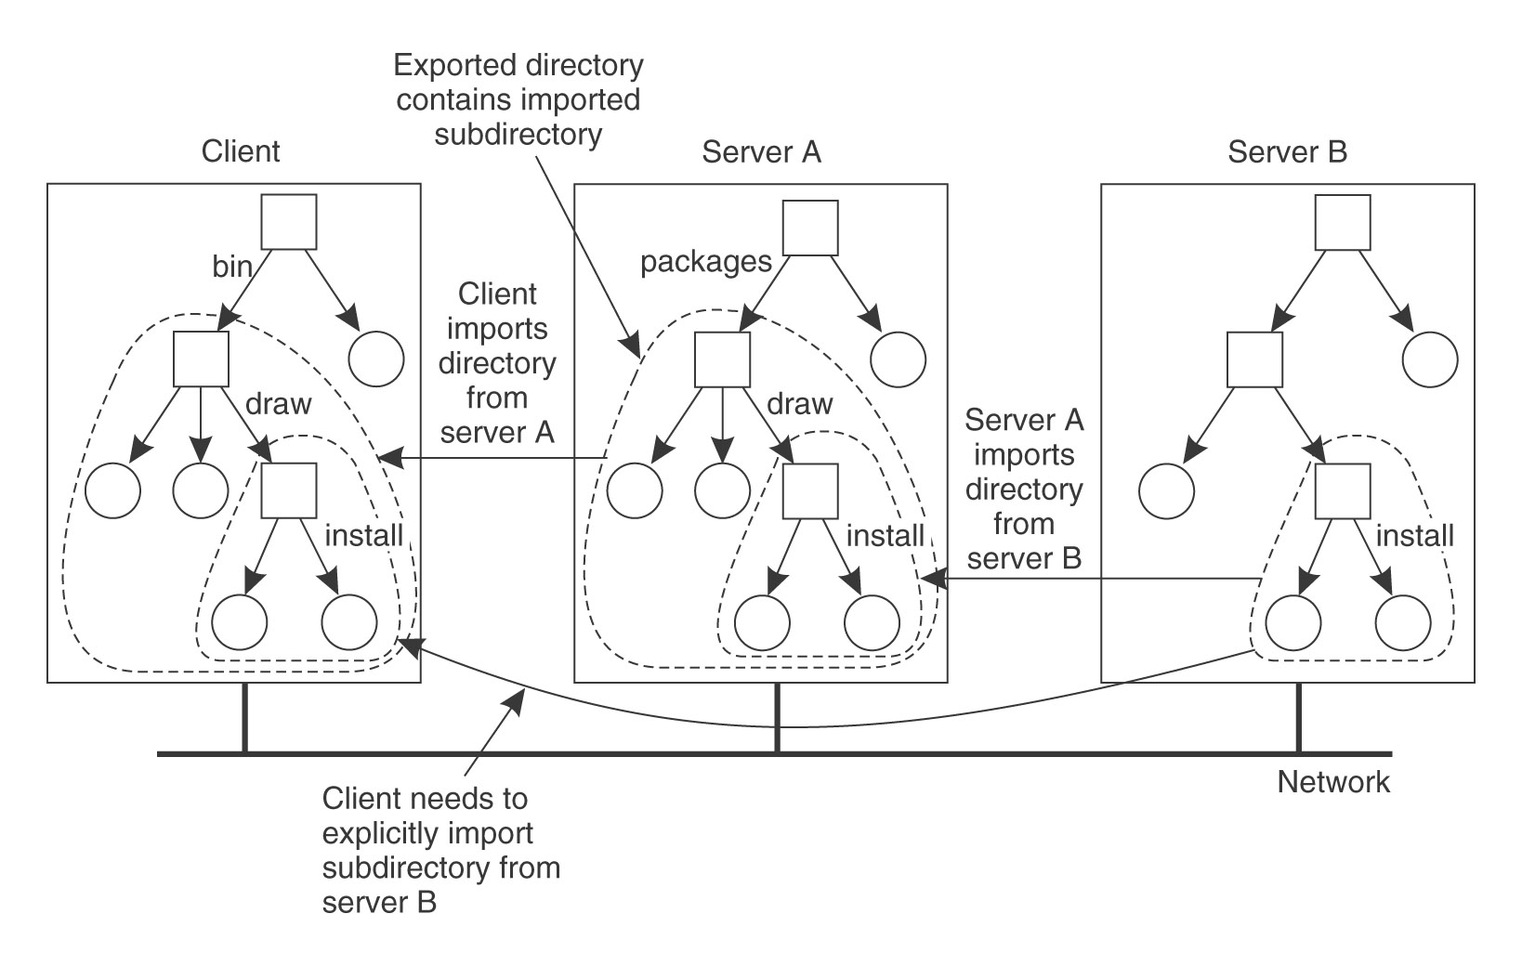
Nested Mounting (NFS)
VFSTR

Slide 23

NFS Implementation
NFS
VFSTR

Slide 24
NFS Operations
Lookup
  Fundamental NFS operation
  Takes pathname, returns file handle
File Handle
  Unique identifier of file within server
  Persistent; never reused
  Storable, but opaque to client
    64 bytes in NFS v3; 128 bytes in NFS v4
Most other operations take file handle as argument
VFSTR

Slide 25
Other NFS Operations (version 3)
read, write
link, symlink
mknod, mkdir
rename, rmdir
readdir, readlink
getattr, setattr
create, remove
Conspicuously absent
  open, close
VFSTR

Slide 26
NFS v3 — A Stateless Service
Server retains no knowledge of client
    Server crashes invisible to client
All hard work done on client side
Every operation provides file handle
Server caching
    Performance only
    Based on recent usage
Client caching
    Client checks validity of caches files
    Client responsible for writing out caches
…
VFSTR

Slide 27
NFS v3 — A Stateless Service (continued)
…
No locking! No synchronization!
Unix file semantics not guaranteed
    E.g., read after write
Session semantics not even guaranteed
    E.g., open after close
VFSTR

Slide 28
NFS v3 — A Stateless Service (continued)
Solution: global lock manager
    Separate from NFS
Typical locking operations
    Lock – acquire lock (non-blocking)
    Lockt – test a lock
    Locku – unlock a lock
    Renew – renew lease on a lock
VFSTR

Slide 29
NFS Implementation
Remote procedure calls for all operations
  Implemented in Sun ONC
  XDR is interface definition language
Network communication is client-initiated
  RPC based on UDP (non-reliable protocol)
  Response to remote procedure call is de facto acknowledgement
Lost requests are simply re-transmitted
  As many times as necessary to get a response!
VFSTR

Slide 30
NFS – Caching
On client open(), client asks server if its cached attribute blocks are up to date.
Once file is open, different client processes can write it and get inconsistent data.
Modified data is flushed back to the server every 30 seconds.
VFSTR

Slide 31
NFS Failure Recovery
Server crashes are transparent to client
    Each client request contains all information
    Server can re-fetch from disk if not in its caches
    Client retransmits request if interrupted by crash
      (i.e., no response)
Client crashes are transparent to server
    Server maintains no record of which client(s) have cached files.
VFSTR

Slide 32
Summary NFS
That was version 3 of NFS
    Stateless file system
    High performance, simple protocol
    Based on UDP
Everything has changed in NFS version 4
    First published in 2000
    Clarifications published in 2003
    Almost complete rewrite of NFS
VFSTR

Slide 33
NFS Version 4
Stateful file service
Based on TCP – reliable transport protocol
More ways to access server
Compound requests
    I.e., multiple RPC calls in same packet
More emphasis on security
Mount protocol integrated with rest of NFS protocol
VFSTR

Slide 34
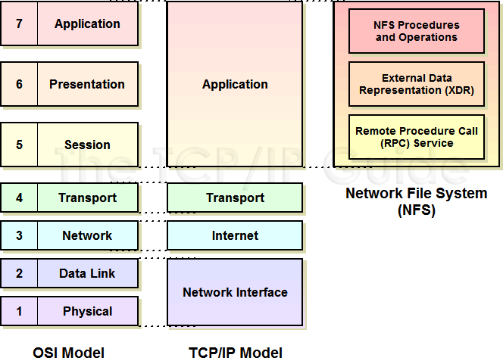
NFS Version 4
VFSTR

Slide 35
NFS Version 4 (continued)
Additional RPC operations
  Long list for managing files, caches, validating versions, etc.
  Also security, permissions, etc.
Also
  Open() and close().
  With a server crash, some information may have to be recovered
See
  Silbershatz, p. 653
  http://www.tcpipguide.com/free/t_TCPIPNetworkFileSystemNFS.htm
VFSTR

Slide 36
Questions?
VFSTR

Slide 37
Andrew File System (AFS)
Completely different kind of file system
Developed at CMU to support all student computing.
Consists of workstation clients and dedicated file server machines.
VFSTR

Slide 38
Andrew File System (AFS)
Stateful
Single name space
  File has the same names everywhere in the world.
Lots of local file caching
  On workstation disks
  For long periods of time
  Originally whole files, now 64K file chunks.
Good for distant operation because of local disk caching
VFSTR

Slide 39
AFS
Need for scaling led to reduction of client-server message traffic.
  Once a file is cached, all operations are performed locally.
  On close, if the file is modified, it is replaced on the server.
The client assumes that its cache is up to date!
Server knows about all cached copies of file
  Callback messages from the server saying otherwise.
…
VFSTR

Slide 40
AFS
On file open()
  If client has received a callback for file, it must fetch new copy
  Otherwise it uses its locally-cached copy.
Server crashes
  Transparent to client if file is locally cached
  Server must contact clients to find state of files
See Silbershatz §17.6
VFSTR

Slide 41
Distributed File Systems — Summary
Performance is always an issue
  Tradeoff between performance and the semantics of file operations (especially for shared files).
Caching of file blocks is crucial in any file system, distributed or otherwise.
  As memories get larger, most read requests can be serviced out of file buffer cache (local memory).
  Maintaining coherency of those caches is a crucial design issue.
Current research addressing disconnected file operation for mobile computers.
VFSTR

Slide 42
Reading Assignment
Silbershatz, Chapter 17
or
Tanenbaum, Modern Operating Systems
  §8.3 and §10.6.4
or
Tanenbaum & van Steen, Chapter 11
VFSTR

Slide 43
Questions?
VFSTR

